Slide 1
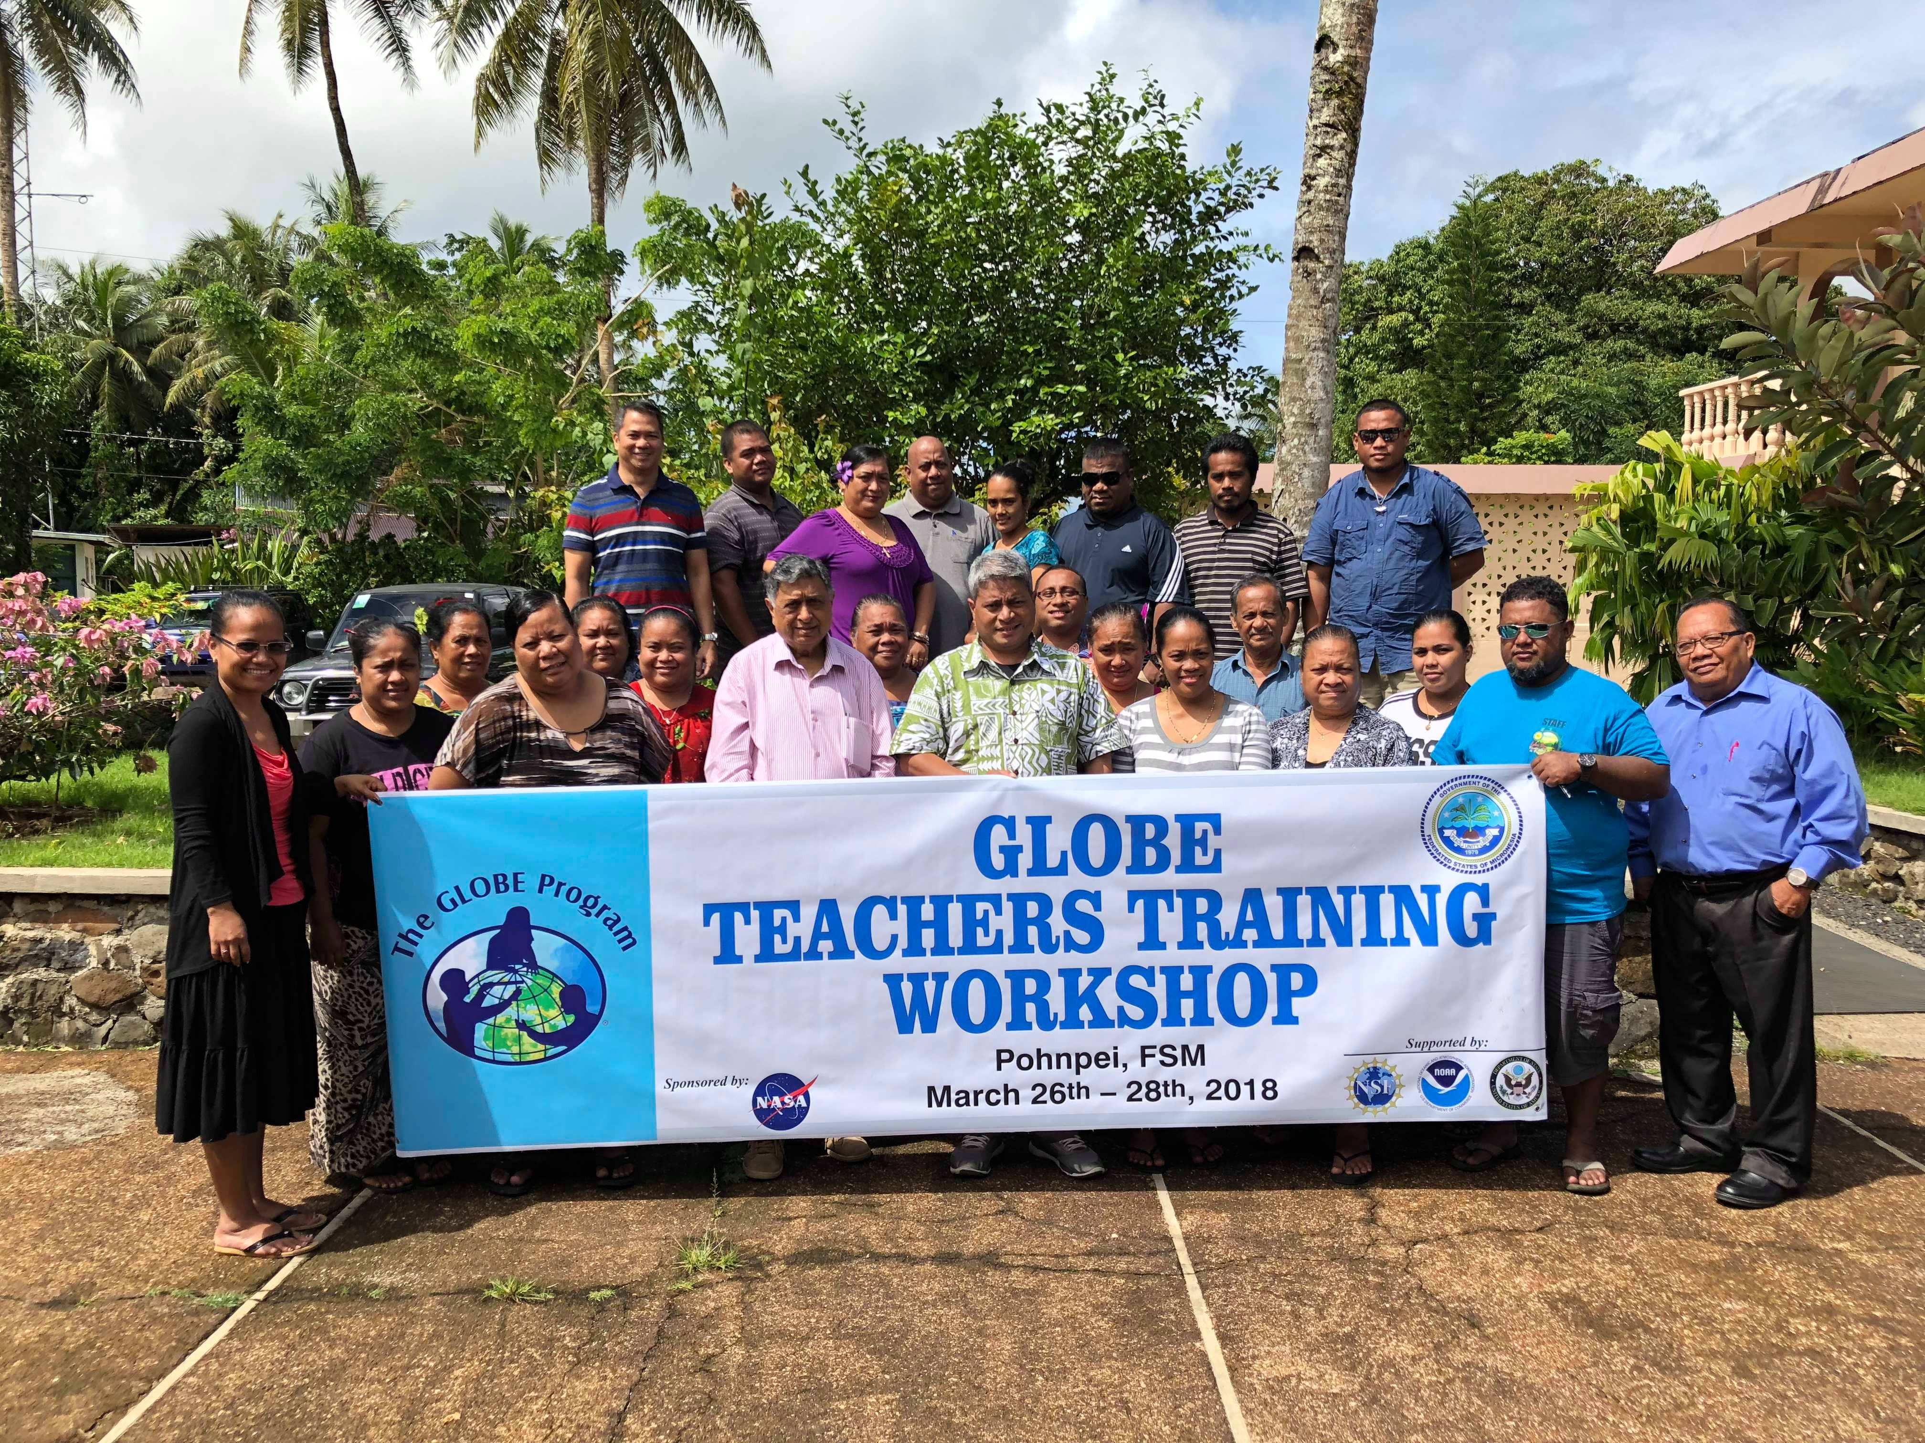
Asia Pacific Regional Meeting
Micronesia GLOBE
Notes:
Welcome to the Federated States of Micronesia. My name is and I Work for the National Government in the Department of Education as a program Administrator for FSM Schools Accreditation System and Bridging Gaps Outreach Program. This here is our department logo and department motto; Strive Toward Excellence. Our main responsibility is to set minimum standards for education and provide oversight and technical assistance to the State Departments of Education whose role is implementation of the education system. You know I told Desh that I won’t come to this regional meet because we did not make ends meet in last year but Desh insisted…Desh is a nice guy. He said come and lets meet to talk about plans for Micronesia and meet your GLOBE family. After yesterdays presentations, I can’t am just in…..but hey we family right??? We help each other out.

Slide 2
FSM Overview
The Federated States of Micronesia Is a 26 year old island nation country formerly Trust Territories of the Pacific after WWII.
Government: Constitutional Confederation in Free Association with the US.
Population-106,000 (2013 Census)
It has four States that are comprised of 607 islands, and a combined land area of 700kilometers sq.
Land area is small but it occupies 2,600,000 km or 1million square miles of the Pacific Ocean, giving the country the 14th largest Exclusive Economic Zone (EEZ) in the World.
Providing services to 187 schools, 27000 students, and 1 thousand teachers spread across or scattered around the 1million square miles of ocean.
Nan Madol: Ceremonial Centre of Eastern Micronesia in the Federated States of Micronesia was inscribed both on the World Heritage List and on the List of World Heritage in Danger. (July 2016 inscribed)

Slide 3
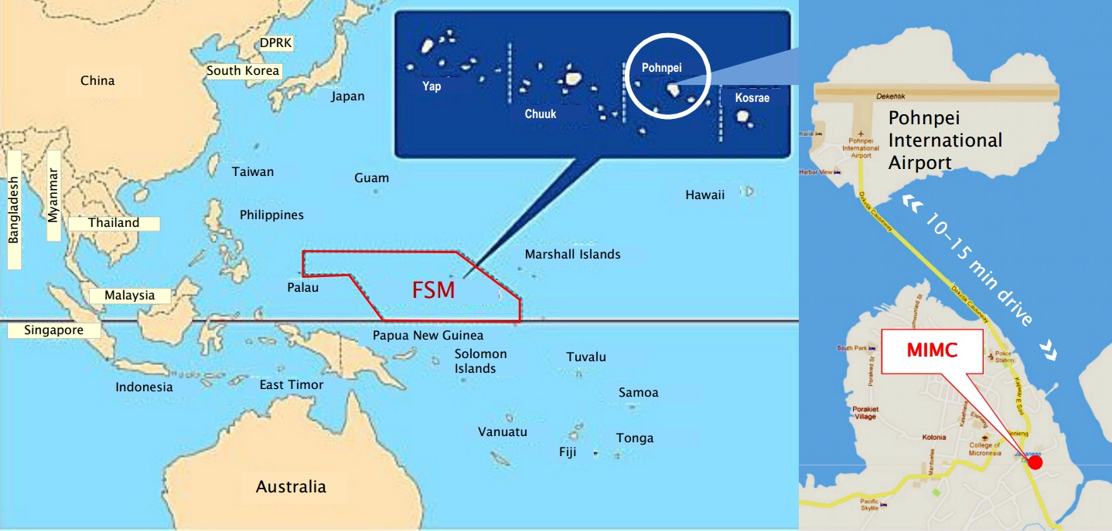

Slide 4
Past and Present Globe Record
IN 2018:
First Teacher Training in Pohnpei, capital State of Micronesia, with the leading support From Dr. Murphy (GIO) and Dr. Bandhu, Asia Pacific RCO.
Successful collaboration with GIO and RCO to receiving GLOBE Program in Micronesia and conducting Teacher Training workshop.
There are now 13 GLOBE schools and 18 GLOBE teachers
25 GLOBE Schools 2019
Joined GLOBE in 1997
FSM was only known to have joined but no records showing activity from this point until recent years. (Had Five GLOBE Schools (187 school count)
Re-connected with GLOBE in some years ago
Re-activated in 2015 year
2016-18- participated in GLOBE RM and trainings on protocols
Consultations held with the Government and partners

Slide 5
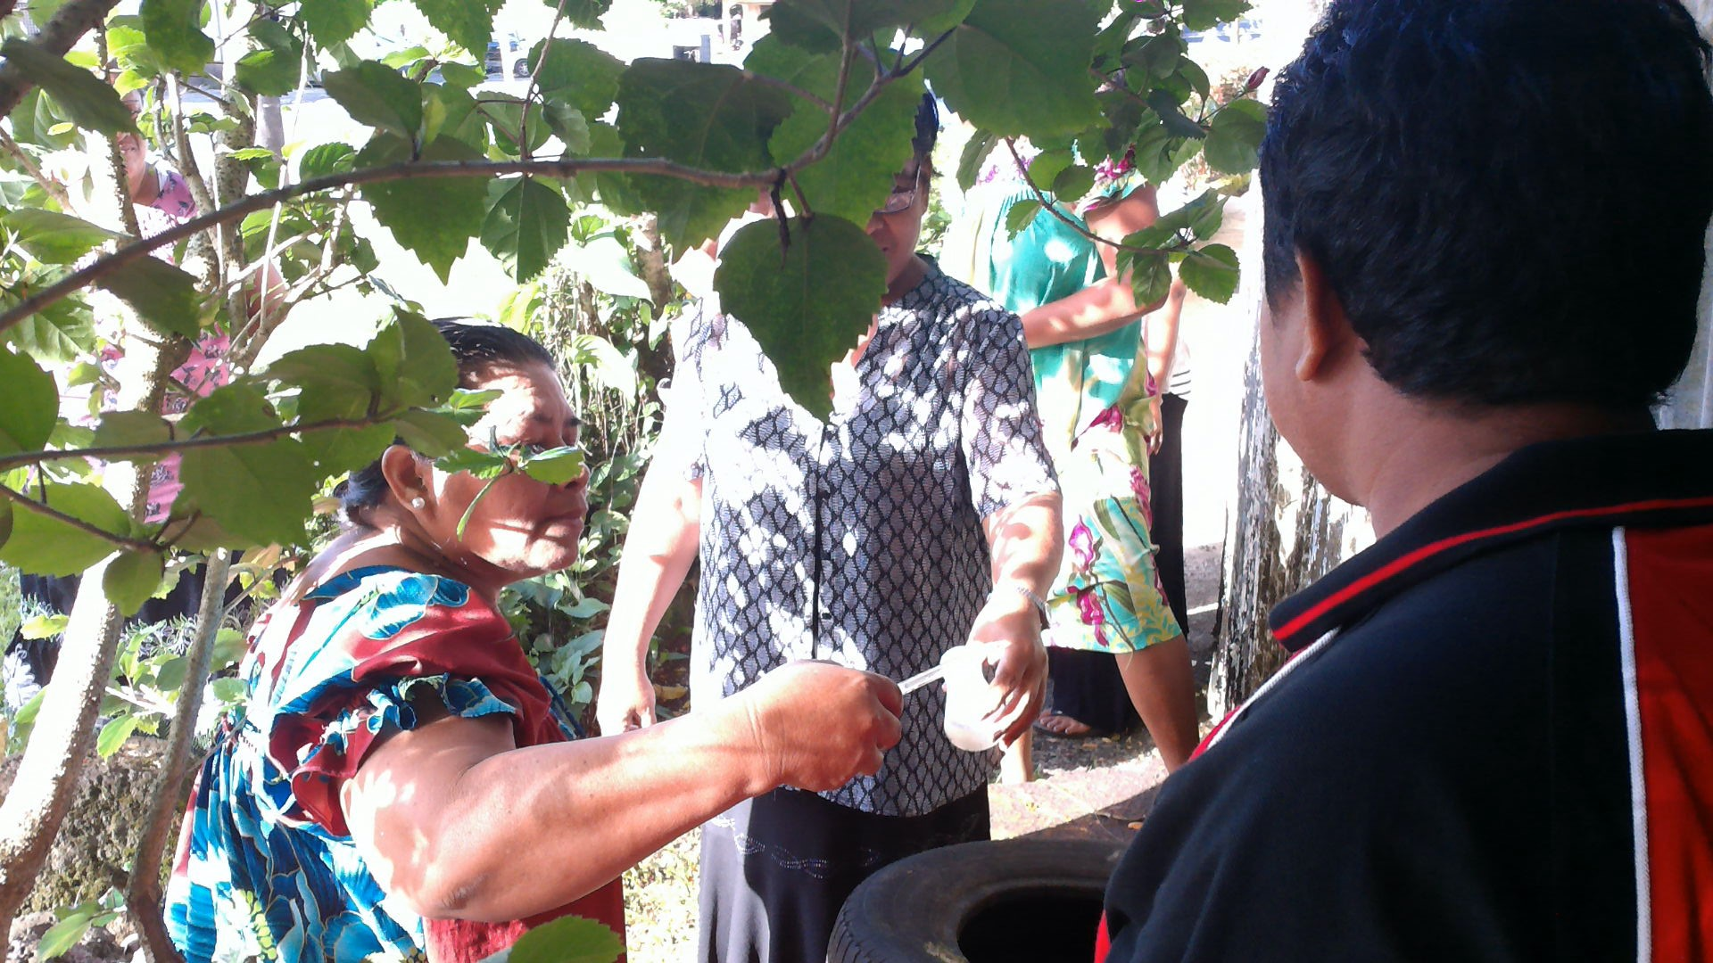
GLOBE Micronesia 2018-2019 *Protocol Training continued-25 GlOBE Schools participated *Zika Implementation

Slide 6
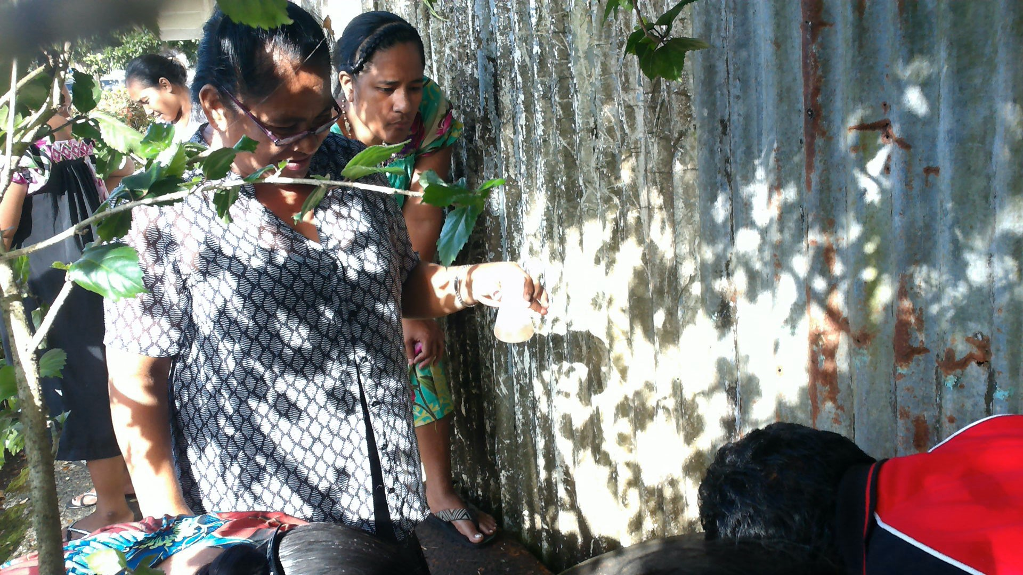
Zika Project Implementation 2018-19
Number of CMT
3 Country Mosquito Trainings
46 participants total for 3 CM
Number of LMT
No LMT
Number of participants completed Pre and Post surveys
1st CMT – 10 completed
2nd CMT – 15 completed
3rd CMT – 11 Completed
Number entered Globe Website

Slide 7
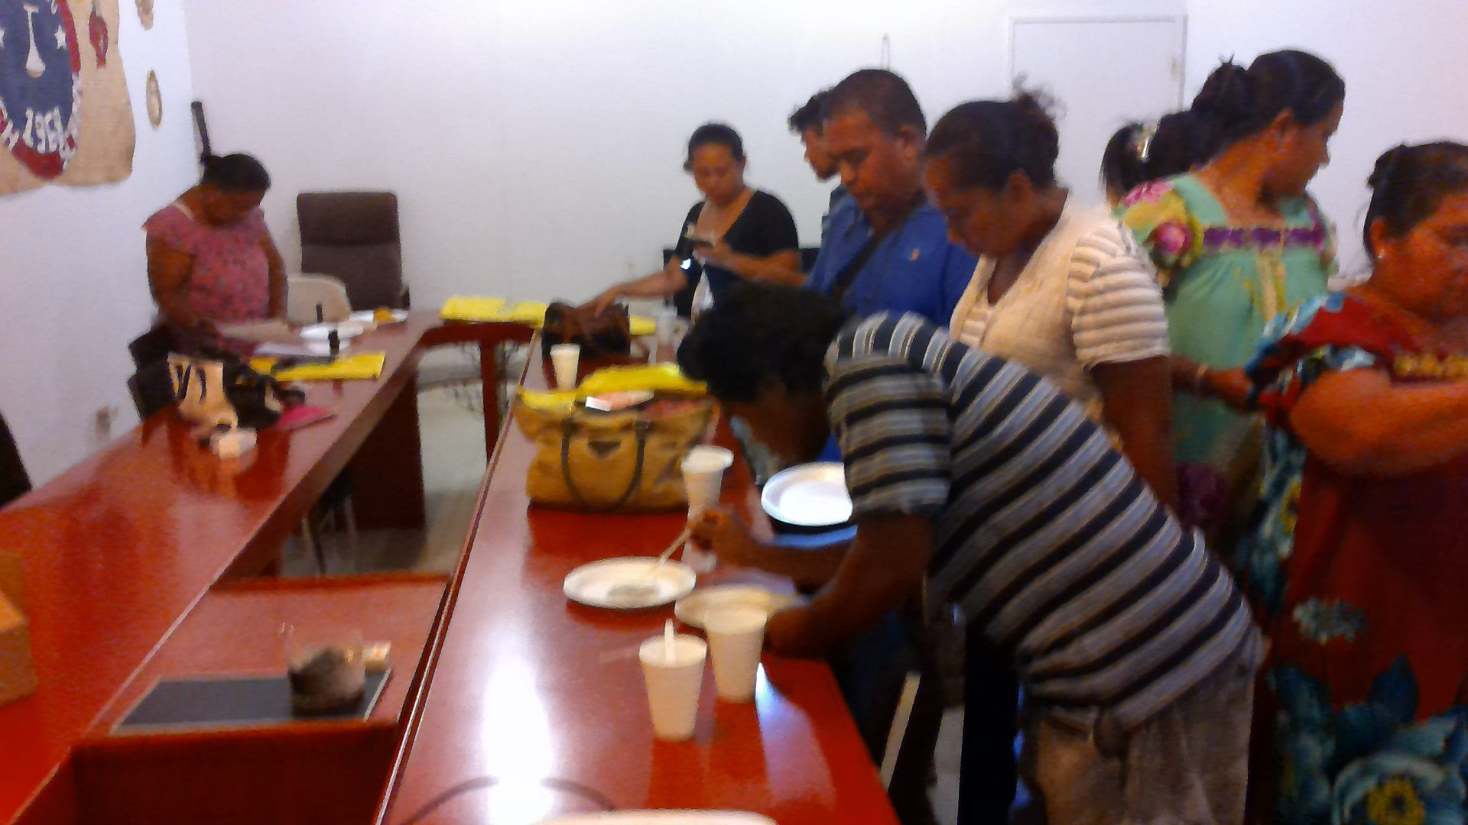
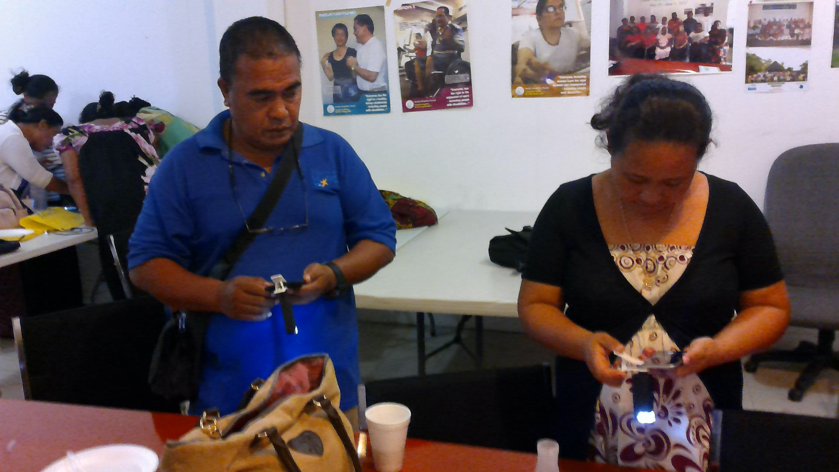
Training days

Slide 8
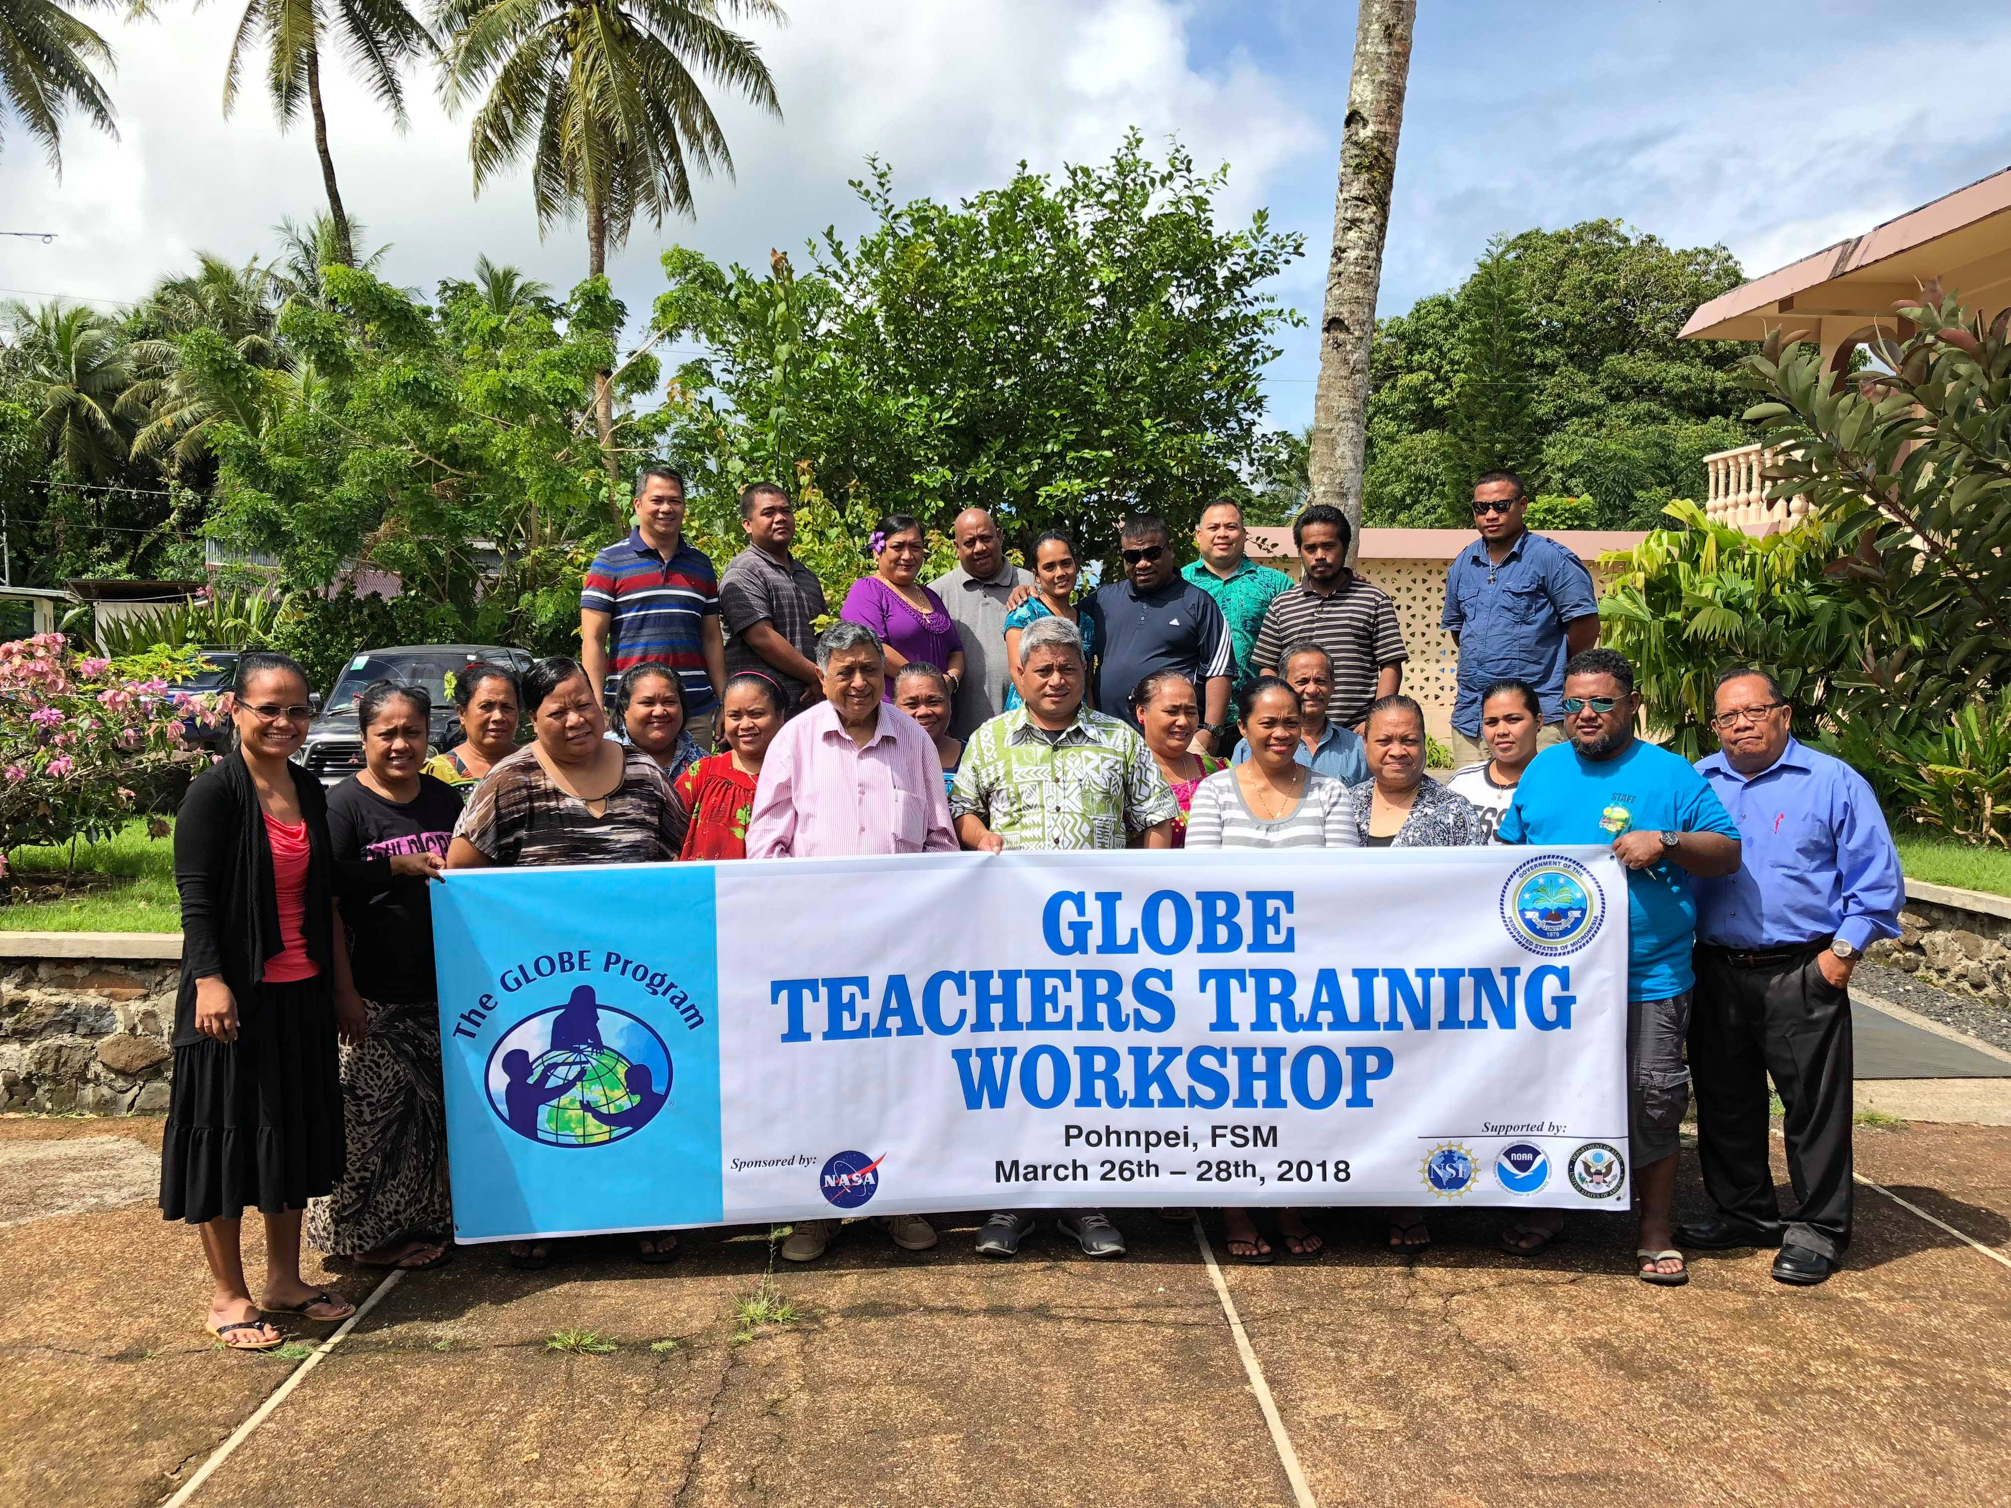
Thank you

Slide 9
GLOBE MICRONESIA Country Report
Cooperating Oganizations:
4 State Education Departments and Pohnpei Weather Service Office (NOAA)
Participating Schools: 25 Schools and teachers in 2018 and over 100 students currently being taught and some have started conducting observations and investigations.
Funding by: FSM National Government (minimal)
UN Development Program( UNDP and NOAA collaboration)
GLOBE protocols used in the country:
Teachers trained in Atmosphere, Hydrology and Soil Protocols. At the moment the teachers are implementing Atmosphere protocols in their schools.
Schools reporting data: Theschools currently reporting as you see evident here in the Visualization System and GLOB E Data Entry site.
map

Slide 10
. Successes/Challenges / Way Forward
Follow up Visits to GLOBE Schools (Detailed in 2018-2019 Action Plan)
Conduct Awareness activities through meetings in the communities.
Continue to seek assistance from GLOBE to conduct more trainings in FSM first before Palau and Marshall Islands.
Conduct Capacity Building Trainings in the protocols, Website and e-Trainings in the other States (Chuuk, Yap and Kosrae)
Build on relationships in place with other organizations. (EPA, Conservation Society, US Embassy/Peace Corp..)
Successful Teacher Training with AP RCO and Dr. Tony Murphy (Virtually) assistance and support- 18 teachers and 13 GLOBE school
GLOBE Data Entry Reported by 5 schools
Geography- Isolation of the schools is the greatest challenge.
Funding Support (Training in the islands, Tools to implement GLOBE)
Capacity to extend the trainings ( Travel and materials is very minimal)
Notes:
Well, if you think about it 602 islands over

Slide 11
Kalahngan. Thank you
Sa
Notes:
GLOBE family members Salamat and Thank you!!! Please I know you want to applaud but save it for the presentation after Palau. LOL…

